Slide 1
DSLE 3-3 Prototype
Product Leaderboards
Loyalty System
The team:
Diogo Costa Pinto
Duarte Souto Assunção
Francisco Calado Araújo
Francisco Lopes Mendonça
Francisco Resende Fernandes
Hugo Alexandre Almeida Barbosa

Slide 2
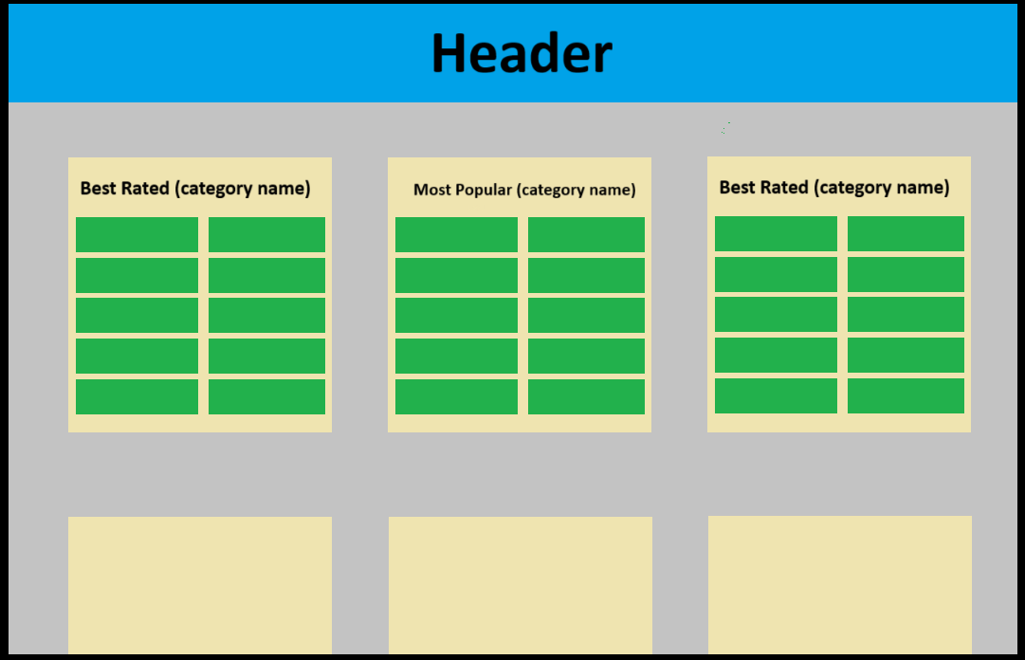
Product Leaderboards

Slide 3
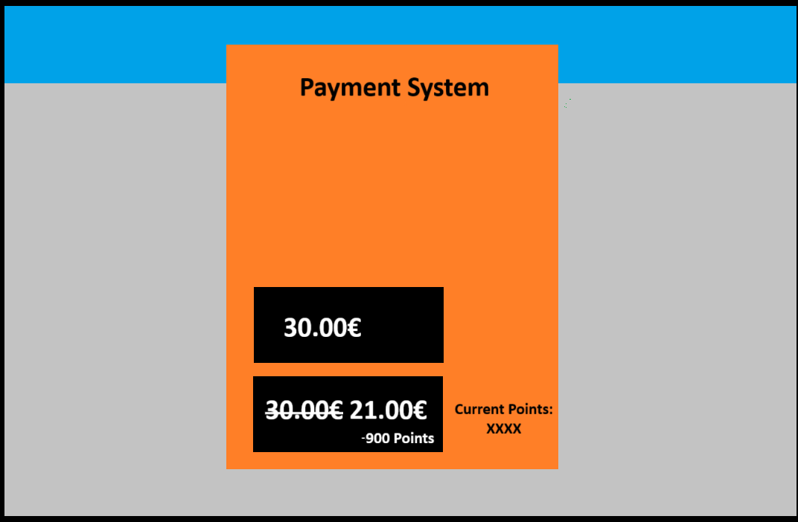
Loyalty System

